Slide 1
AXLE CASING CRACK AT DH MTG FACE

Slide 2

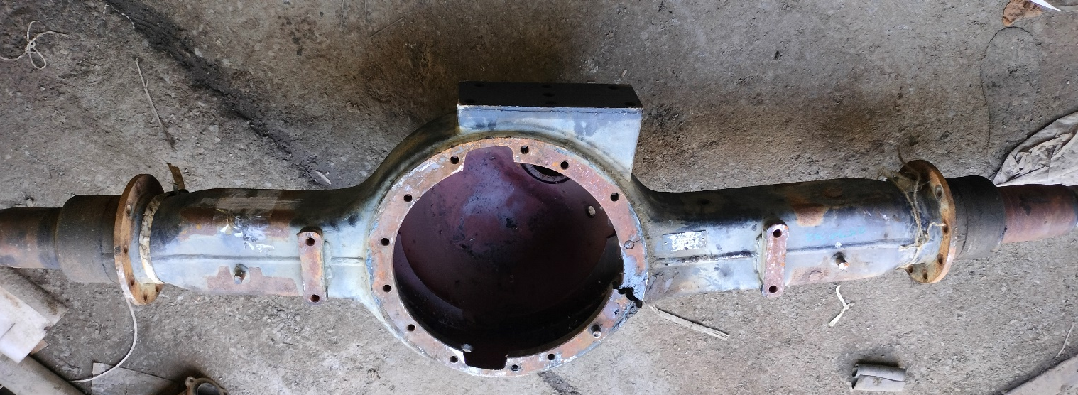
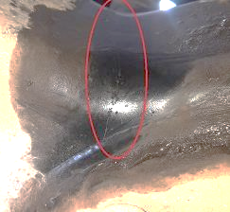
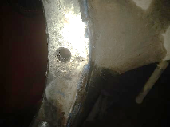
Casing crack in 10X4 DTLA Tipper - Meritor
Complaint / Problem details |  | Casing crack at drive head mounting face – 16TG |  |  |  | Issue status | RL5
 |  |  |  |  |  | Issue grade | V1
Model |  | 4825 DTLA 10x4 Tipper | Failure Hrs | 149-3946 Hours (95% > 500H) |  | DOF | Till Sep’22
Mfg plant |  | H2 & PNR | No of cases | 95 |  | Resp | Appln / PD
Observation/ Root cause | Observation: RA1 axle casing crack at ham radius 4 ‘O clock position reported in field which are operated as per LR spec & MOR not fitted. Field application study carried out for 5 vehicles at Surat & following are major observations GVW found upto 54T – as per LR spec (L2). As per Customer voice, max 54T being allowed in L&T project RAW/ axle found upto 15.8T in LA down condition with GVW 54T RAW/axle found upto 18.5T in LA lifted condition with GVW 51.3T which can go upto 19.5T RAW/ axle with GVW 54T for which 16TG axle is not recommended 2 out of 5 vehicles reported for failure found operating in LA lifted condition with load All 5 vehicles have reported for Bogie U bolt failure and LA malfunction Failed Axle casing material conforms to Meritor spec Competition (TATA 4825) found with axle equivalent to 18TG. Root cause: RAW/Axle found Upto 19.5T with GVW 54T (with LA lifted condition). Hence, PD proposed 18TG axle |  | Photos / Illustration |  | Illustration
 |  |  |  |  | v
Action | Permanent actions : PD proposed 18TG ultimate as 4825 DTLA 10X4 Tipper (BGS models) - As huge investment is involved, the interim 18TG MULE casing will be continued as permanent action 18TG MULE casing as per ER-DIN-0089057 dt. 06-Jul-22 implemented. C: Sep’22

Slide 3
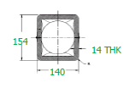
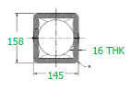
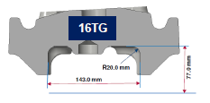
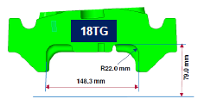
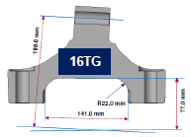
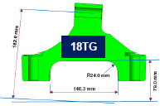
Casing crack in 10X4 DTLA Tipper – Meritor
Permanent action
Before (16TG)
After (18TG)
Box Section(In mm)
154x140x14
Box Section(In mm)
158x145x16
Spring seat (In mm) 143x77 & R 20
Spring seat (In mm) 148.3x79 & R 22
Bottom bracket (In mm)
141x77 & R 22
Bottom bracket (In mm)
146.3x79 & R 24

Slide 4
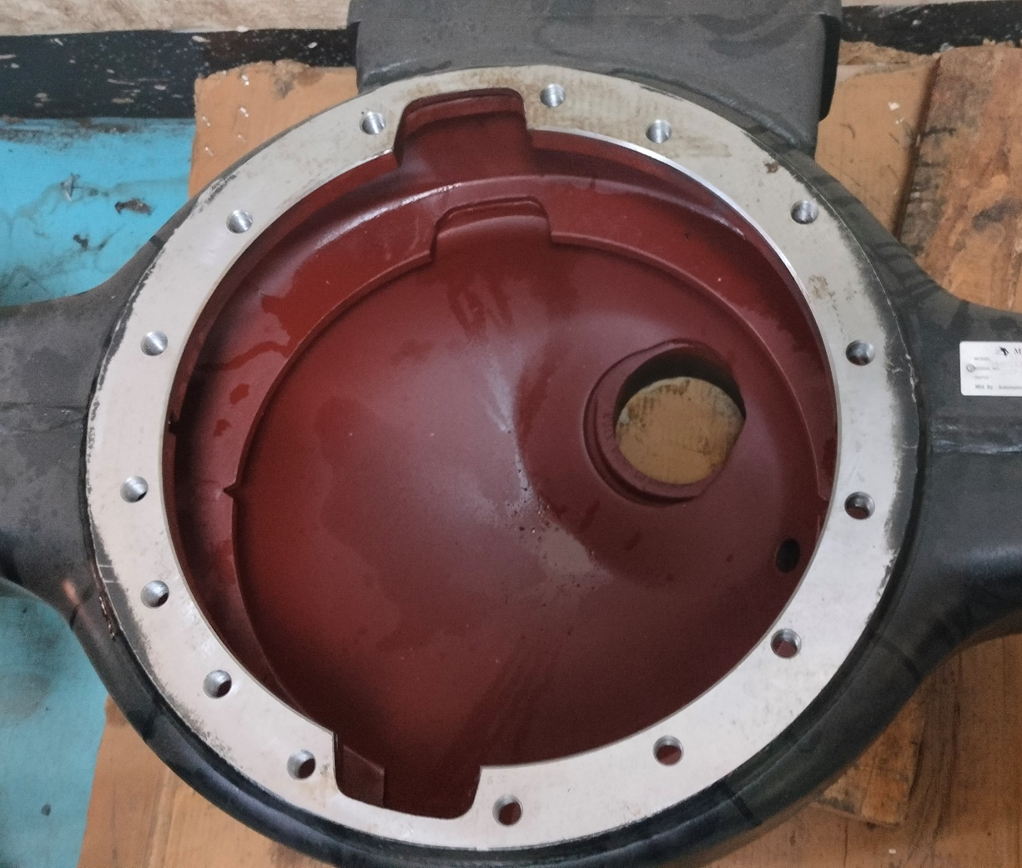
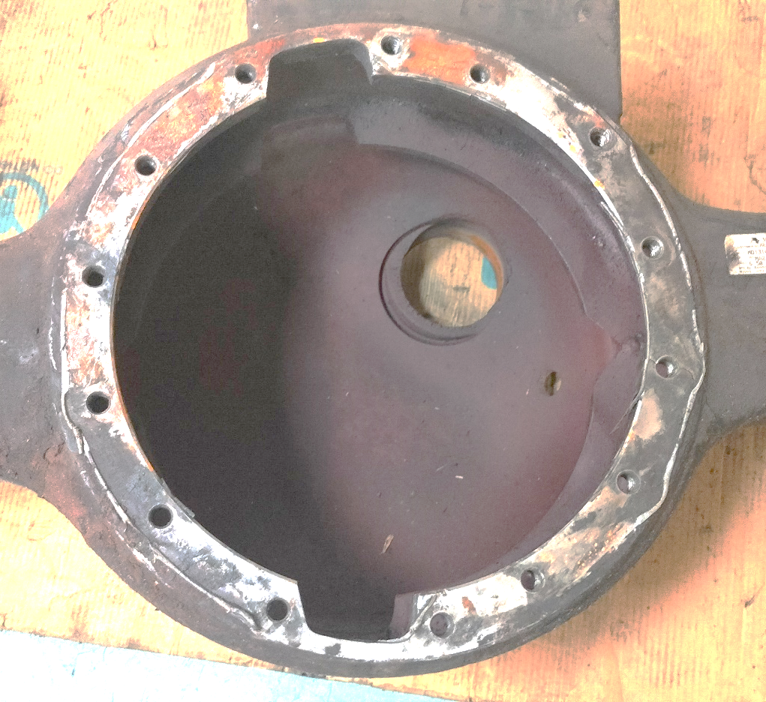
Drive head mounting holes position in Axle casing
18TG (15 Bolts) Vs 16TG (14 Bolts)
17.1
12.2
9.6
15.9
10.1
9.6
21.3
8.8
21.9
8.2
9.4
11.6
11.4
9.2
18 TG RA1 Axle casing
16 TG RA1 Axle casing
9.4
10.0
9.3
9.2
11.5
5.7
8.4
8.3
9.6
9.6
11.7
9.5
15.9
10.1
16.9
These are the bolts gets loosening & oil leak predominantly in field

Slide 5
DIFFERENTIAL CARRIER

Slide 6
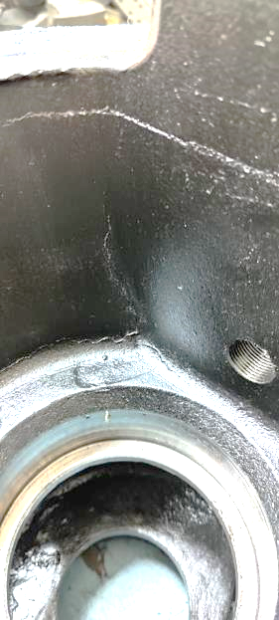
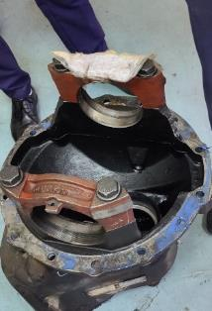
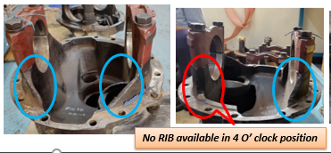
Diff carrier crack @ 4 O’ clock position – Meritor
Complaint / Problem details |  | Diff carrier crack at 4 O’ Clock position in Meritor MT149.7 axle |  |  |  | Issue status | RL5
 |  |  |  |  |  | Issue grade | V1
Model |  | 6x4 Tipper & 8x4 Tipper | Failure Hrs | 113-3992 hours (85% > 500H) |  | DOF | Till Sep’22
Mfg plant |  | H2 & PNR | No of cases | 72 |  | Resp | PD
Observation/ Root cause | Observation: Failure specific to RA1 MT149.7 Tandem axle in 6x4 and 8x4 Tipper Failed carriers conforms to Meritor spec. Differential carrier material found equivalent to SG 450/10 based on hardness and microstructure observations. Fracture surface shows crack initiation from corner and propagating inner to outer. Failures are observed in BS4 Models also. Based on initial analysis, noticed that RIB on Adjuster Ring area at 4’o clock position is missing On verifying different types of Diff carriers, the Rib was present in earlier models which was produced in December 2014 Availability of RIBs verified in other axle make (M/s Dana) and same found available Root cause: NG carrier was introduced in early 2016 as part of VAVE initiative and suspect the RIB was removed at 4 O’ clock position during that time. The rib removal will increase deflection and stress at the location. In addition, fettling process will create sharp edges which makes it more vulnerable. |  | Photos / Illustration |  | Illustration
 |  |  |  |  | v
Action | Interim actions: Fettling process at Tier II supplier ensured free from digging mark. C: Jun’22 Permanent actions : The removed rib at 4 O’ clock position will be reintroduced in 15i-Fwd Carrier (15 bolt version). C: Jan’23

Slide 7
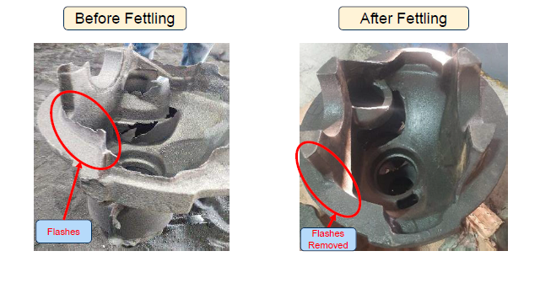
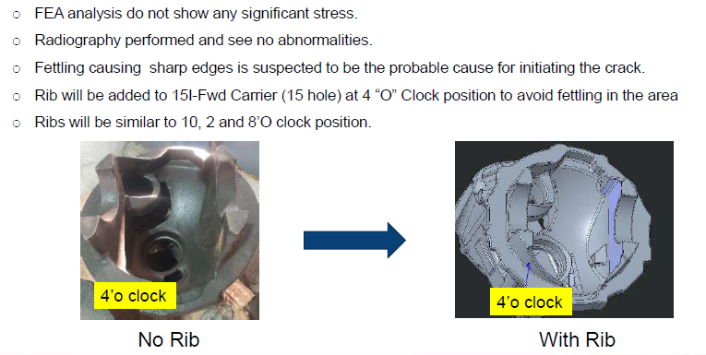
Diff carrier crack @ 4 O’ clock position - Meritor
Interim action & Permanent action
Before
After
INTERIM ACTION
PERMANENT ACTION
MT149.7 without RIB
MT15i with RIB

Slide 8

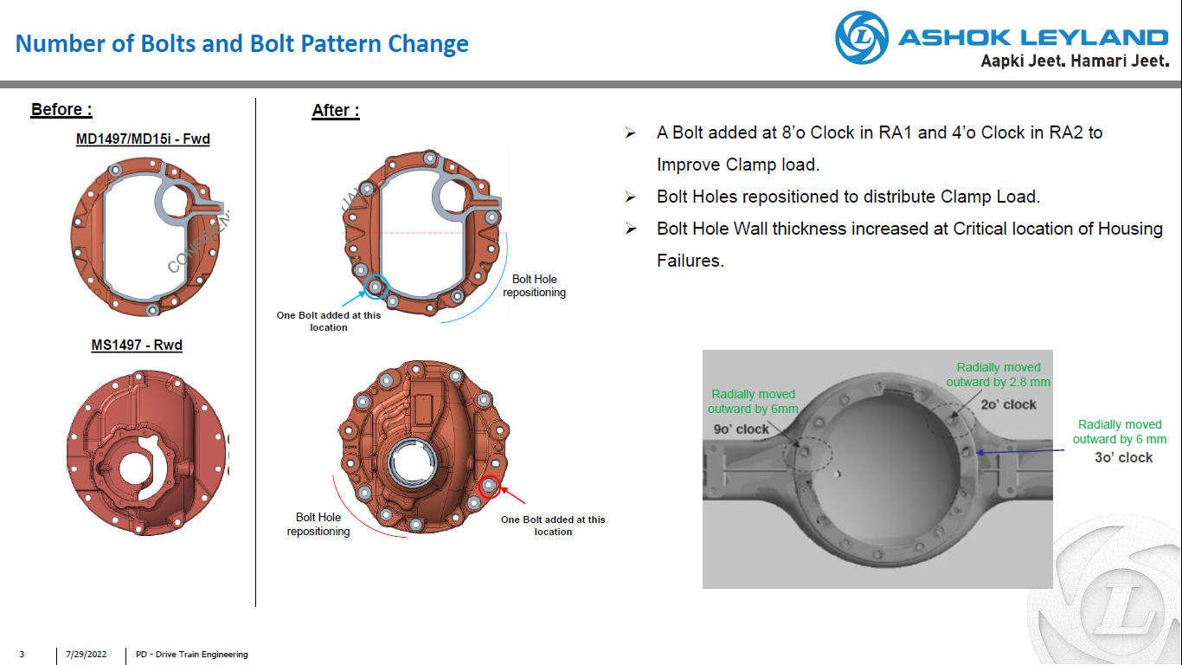
Diff carrier crack @ 4 O’ clock position
Permanent action
Before
After
RA1
RA1
RA2
RA2
MT 15i with 15 Bolt holes
(A Bolt added at 8 O’ clock in RA1 and 4 O’ clock in RA2
MT 149.7 with 14 Bolt holes

Slide 9
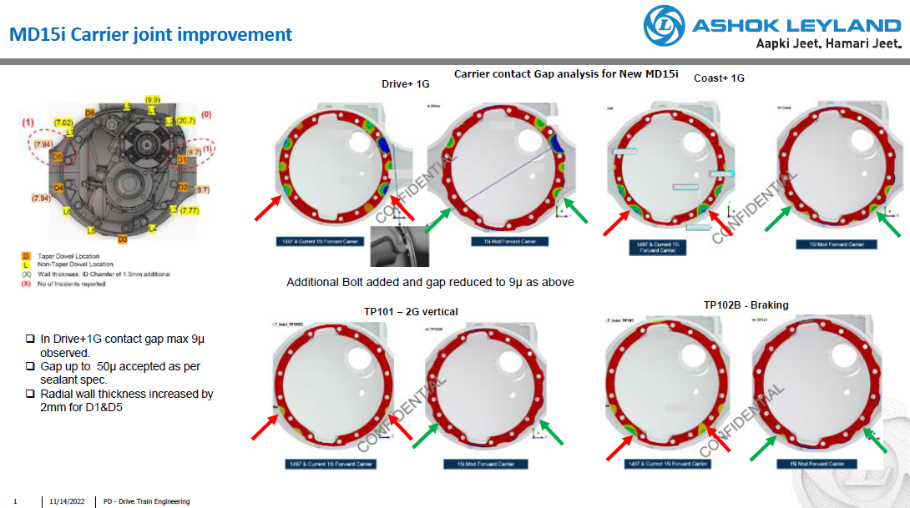

Slide 10
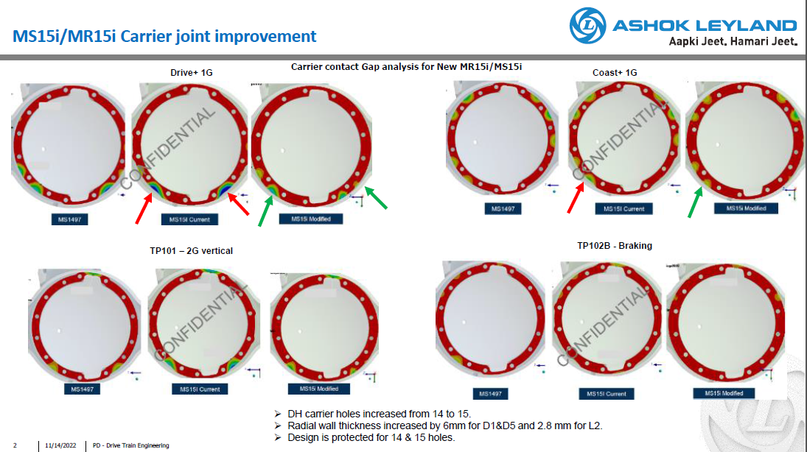

Slide 11
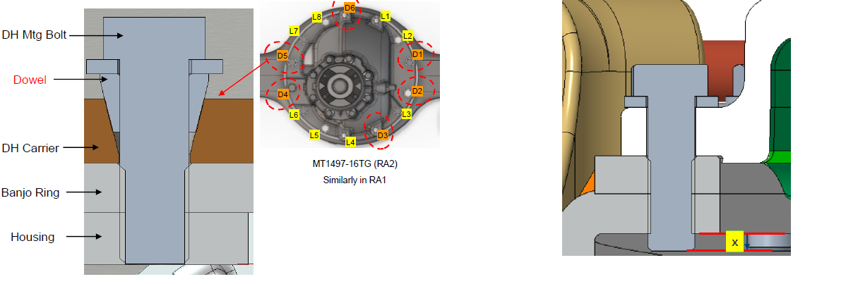
Diff carrier crack @ 4 O’ clock position
Permanent action
Before
After
MT 149.7 With Dowel
MT 15i Without Dowel

Slide 12
HR CASING V ROD

Slide 13
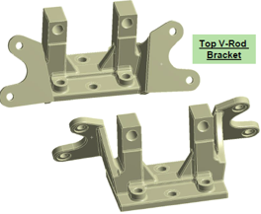
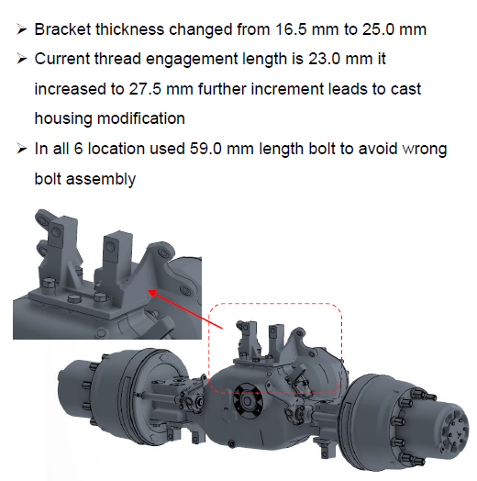
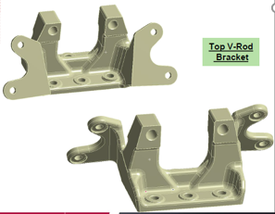
Improved Bracket
Before
After

Slide 14
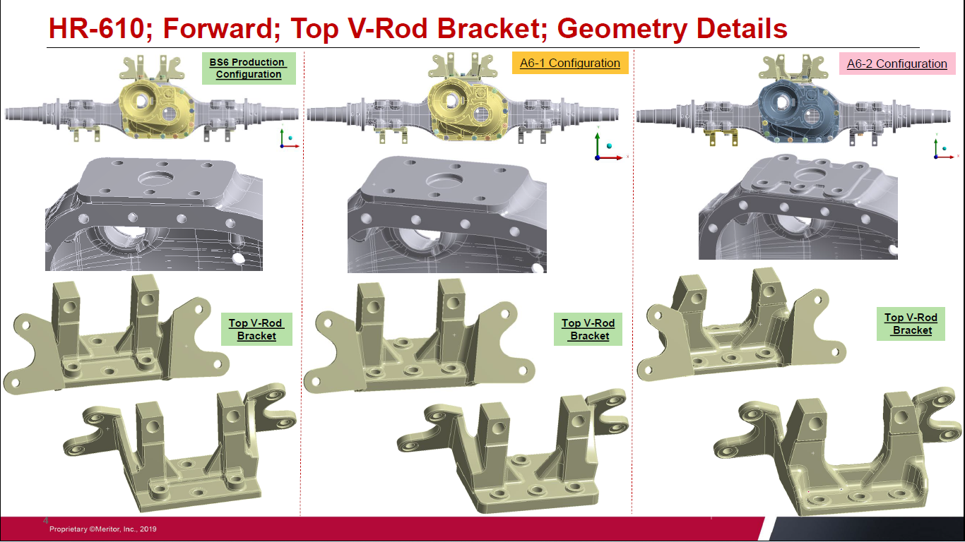
Existing
design
Version 1
Modified design

Slide 15
BACKUP SLIDES

Slide 16
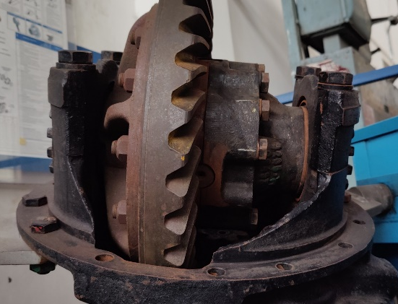
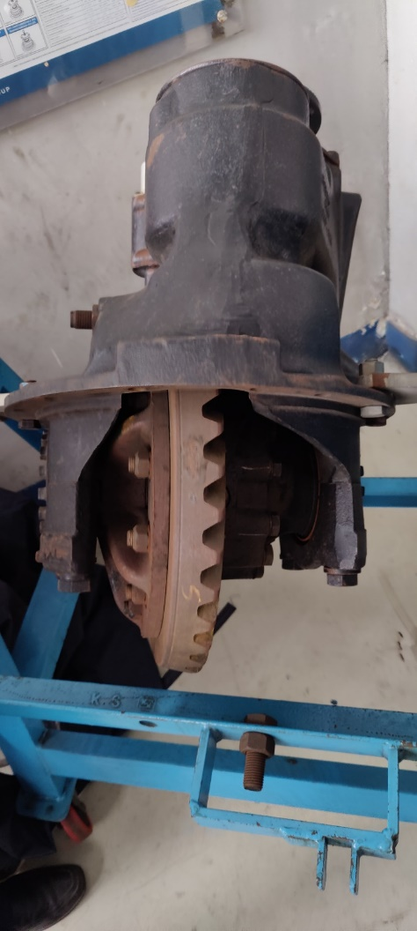
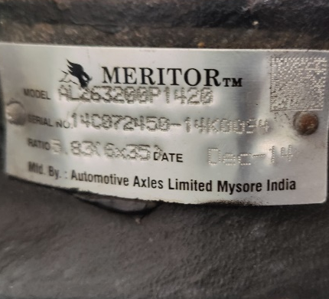
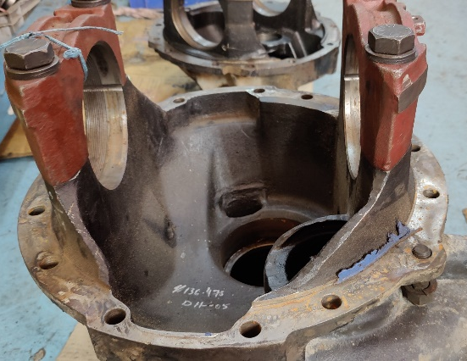
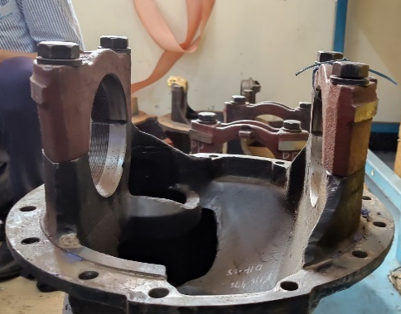
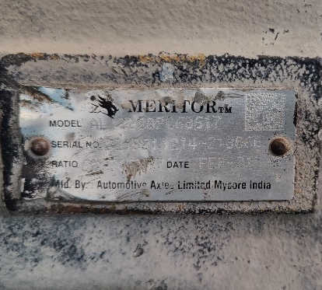
Differential Carrier Types
S.No | Axle Type | Availability of Ribs at Crown brg mtg lugs | Photographic evidence
1 | MT149.5 (RA1) | Ribs available in all 4 locations
2 | MT149.7 (RA1) | Ribs not available in all 4 O’ clock position
2014
RIB available in 4 O’ clock position
2021
No RIB available in 4 O’ clock position

Slide 17
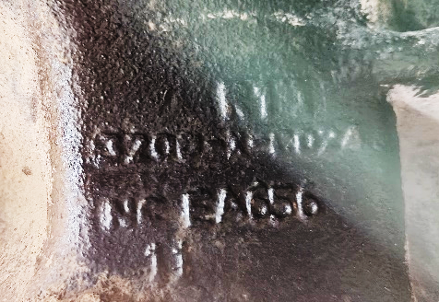
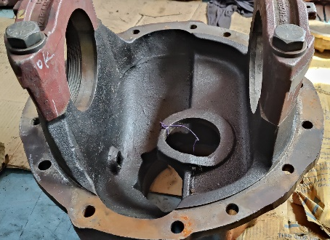
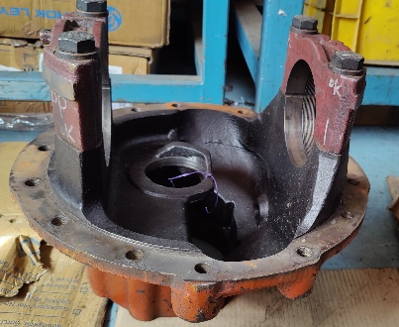
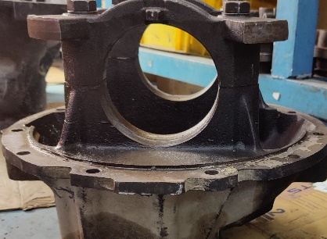
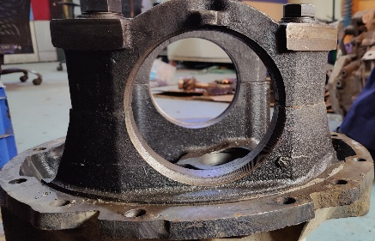
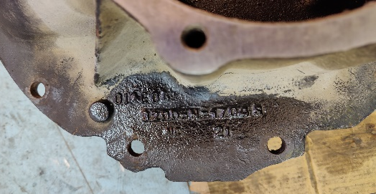
Differential Carrier Types
S.No | Axle Type | Availability of Ribs at Crown brg mtg lugs | Photographic evidence
3 | MT149.7 (RA2 / Solo) | Ribs not available in 2 O’ clock & 4 O’ clock position
4 | MS160 | Ribs available in all 4 locations
2’o clock position
4’o clock position
2020
2021

Slide 18
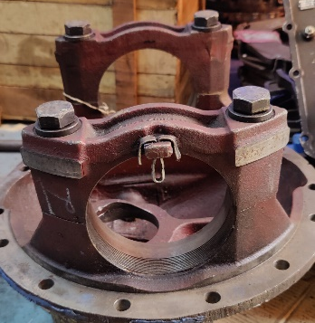
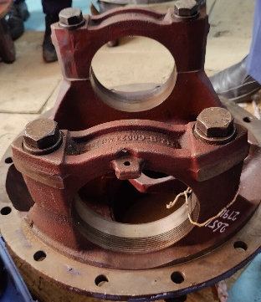
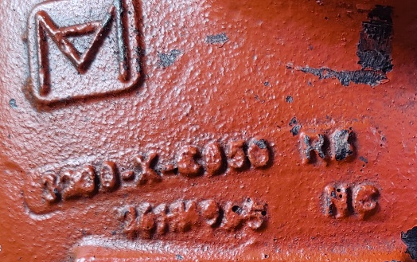
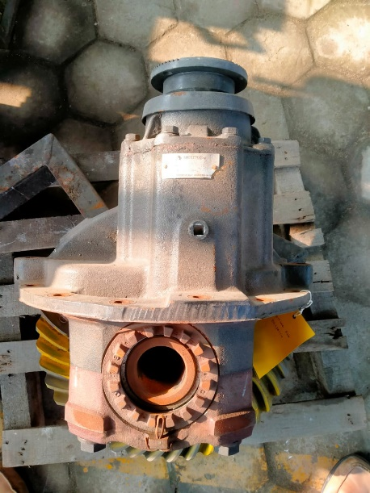
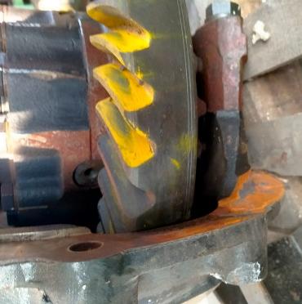
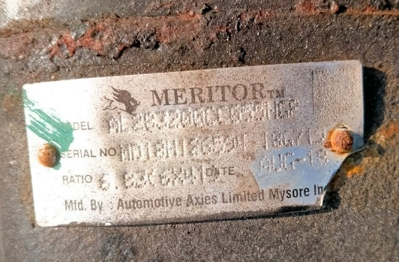
Differential Carrier Types - Meritor
S.No | Axle Type | Availability of Ribs at Crown brg mtg lugs | Photographic evidence
5 | MS149.6 (Passenger) | Ribs available in all 4 locations
6 | MS149.6 (Passenger) | Ribs not available in all 4 locations
2014
2018

Slide 19
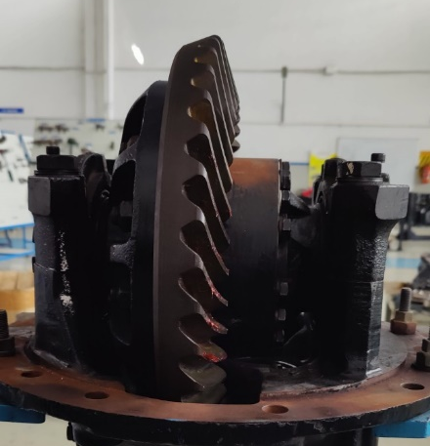
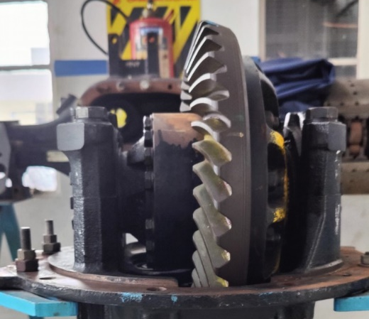
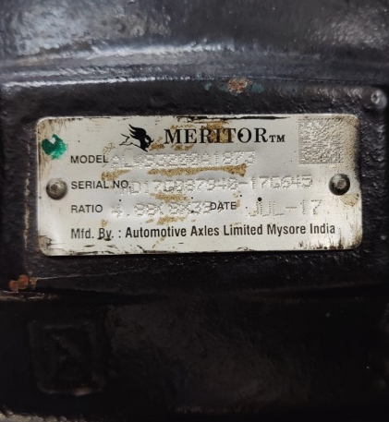
Differential Carrier Types - Meritor
S.No | Axle Type | Availability of Ribs at Crown brg mtg lugs | Photographic evidence
7 | MS145 (Solo) | Ribs not available in 2 O’ clock & 4 O’ clock position
2’o clock position
4’o clock position
2017

Slide 20
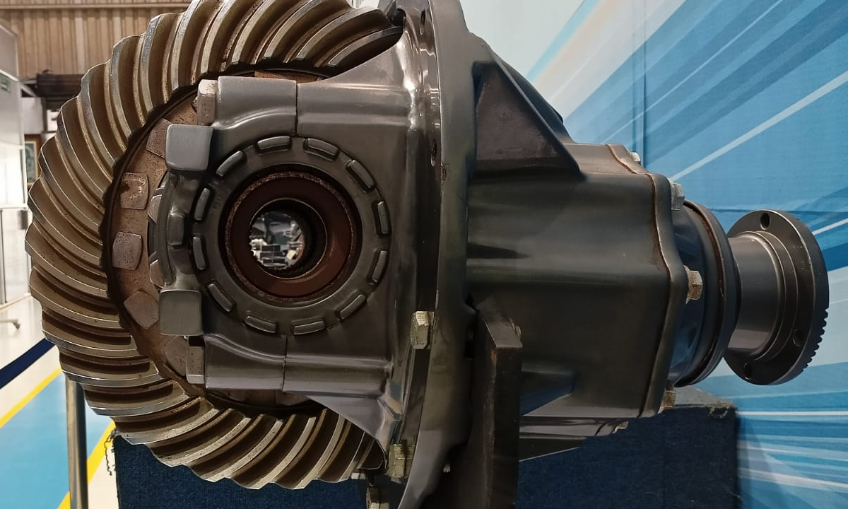
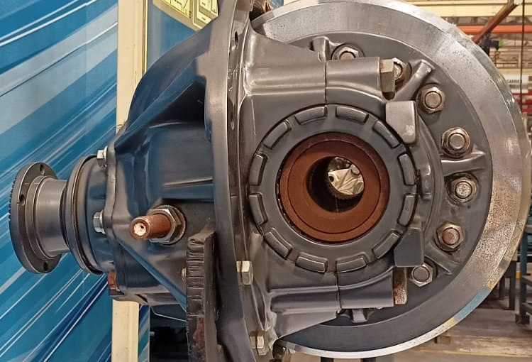
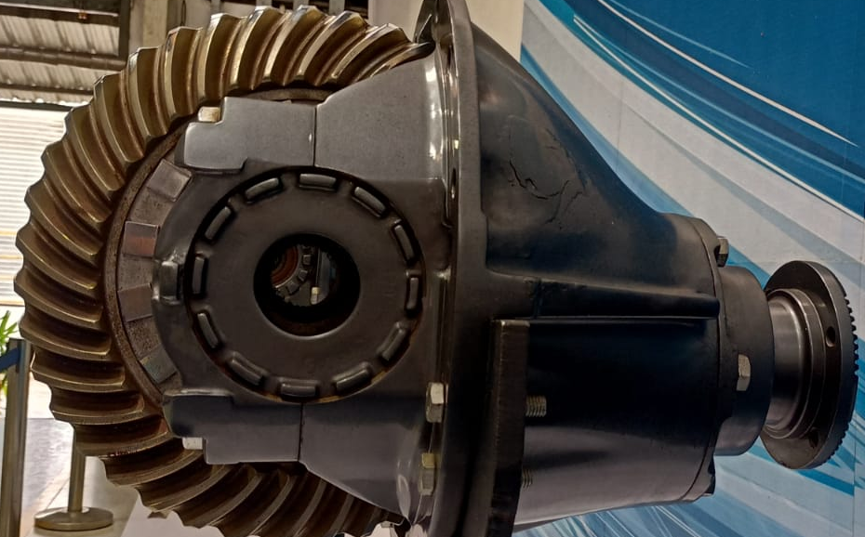
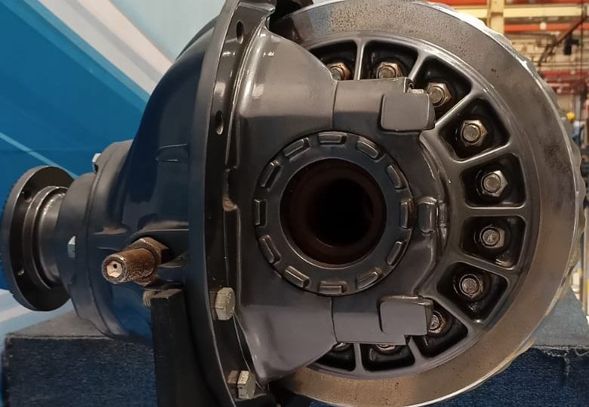
Differential Carrier Types - DANA
S.No | Axle Type | Availability of Ribs at Crown brg mtg lugs | Photographic evidence
1 | DANA 92S | Ribs available in all 4 locations
2 | DANA 60SHO | Ribs available in all 4 locations
2021
2021

Slide 21
Differential Carrier Types - DANA
S.No | Axle Type | Availability of Ribs at Crown brg mtg lugs | Photographic evidence
3 | DANA HDS | Ribs available in all 4 locations
2021

Slide 22
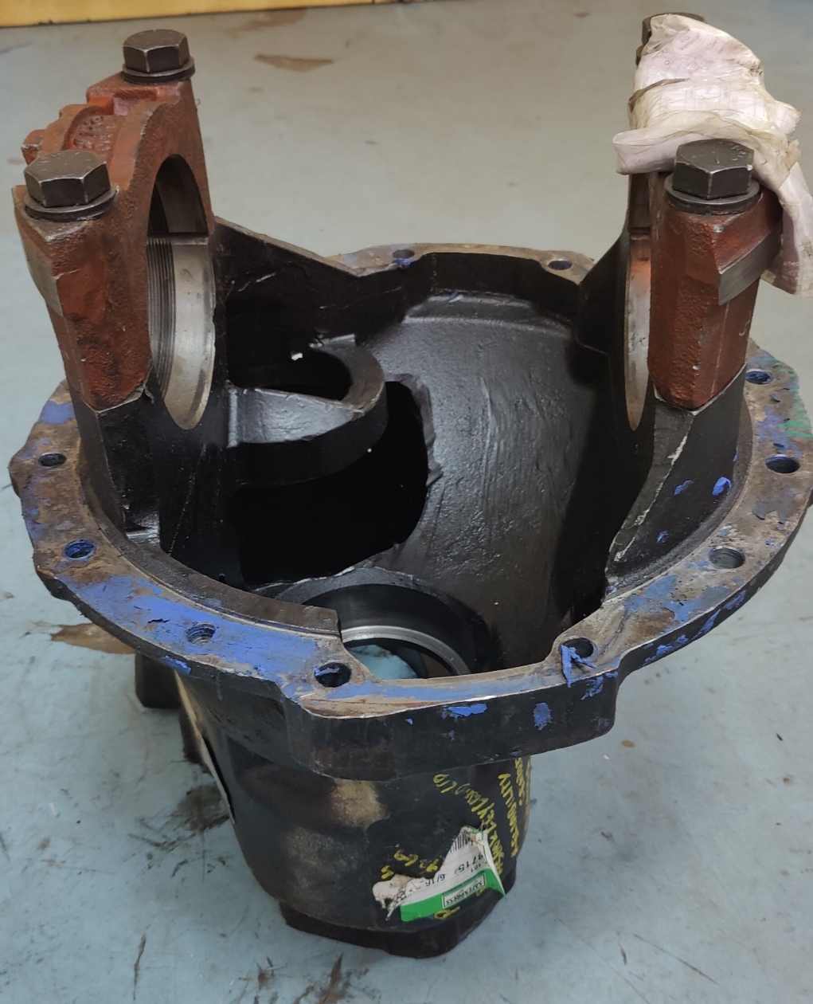



MT149.7 DIFFERENTIAL CARRIER
12’O Clock
3’O Clock
9’O Clock
Make : Meritor
Axle model : MT 149.7
Major segments : 6x4 & 8x4 Tipper
Observation : RIB not available on one side (@ 4’o clock position) of the carrier adjuster ring area
Failure location
6’O Clock

Slide 23



Differential carrier crack at 4’o clock position
Oil leak observed

